Slide 1
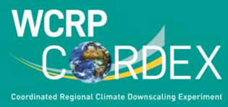
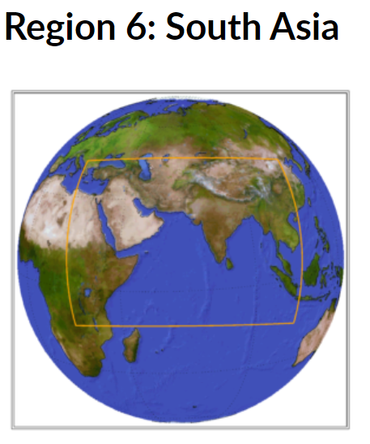
Regional Climate Modeling In The Framework Of CORDEX South Asia
Sanjay Jayanarayanan
Centre for Climate Change Research (CCCR)
Indian Institute of Tropical Meteorology (IITM), Pune, India
An Autonomous Institute of the Ministry of Earth Sciences, Govt.of India

Slide 2
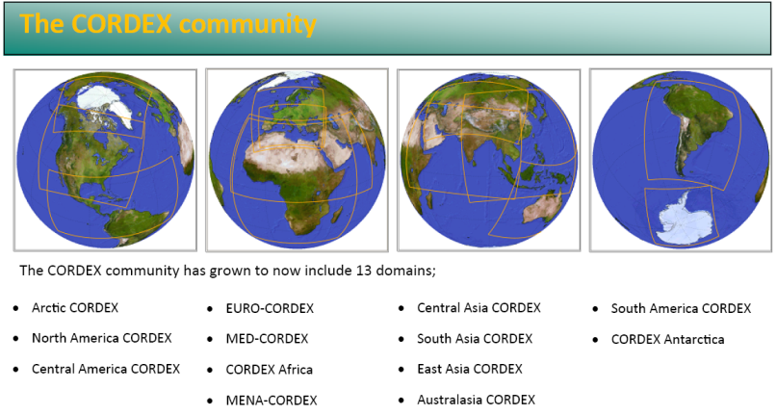
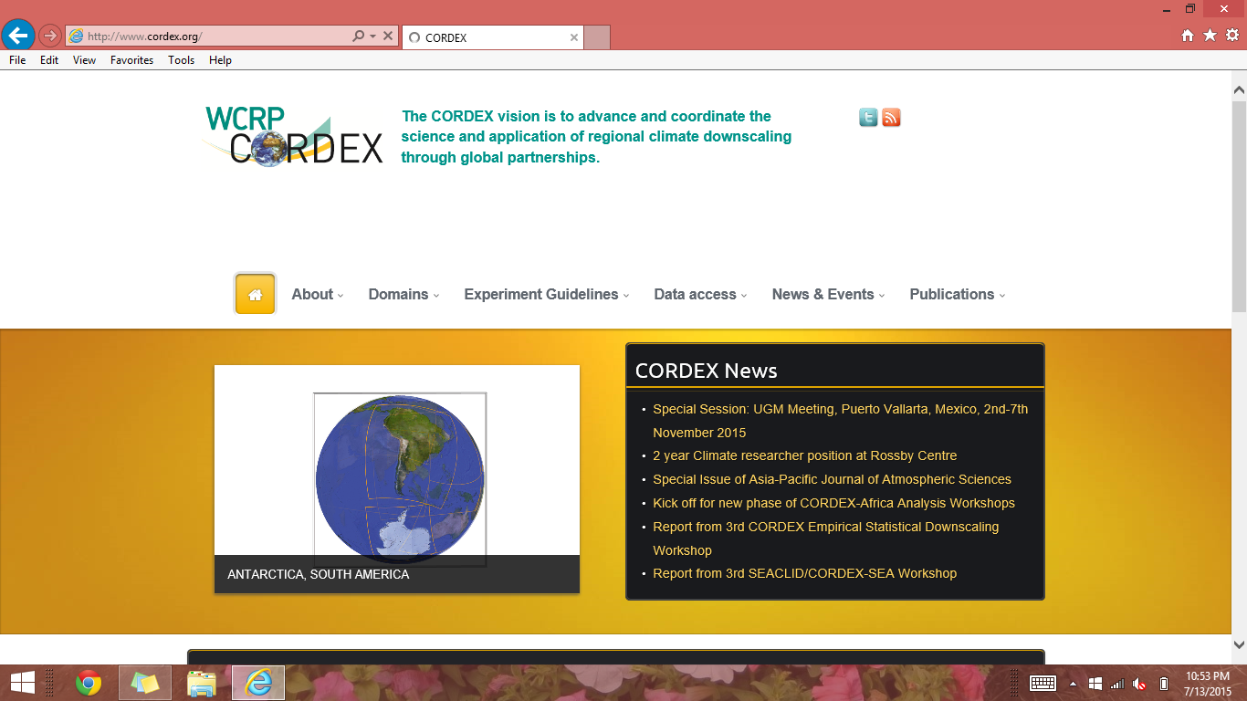
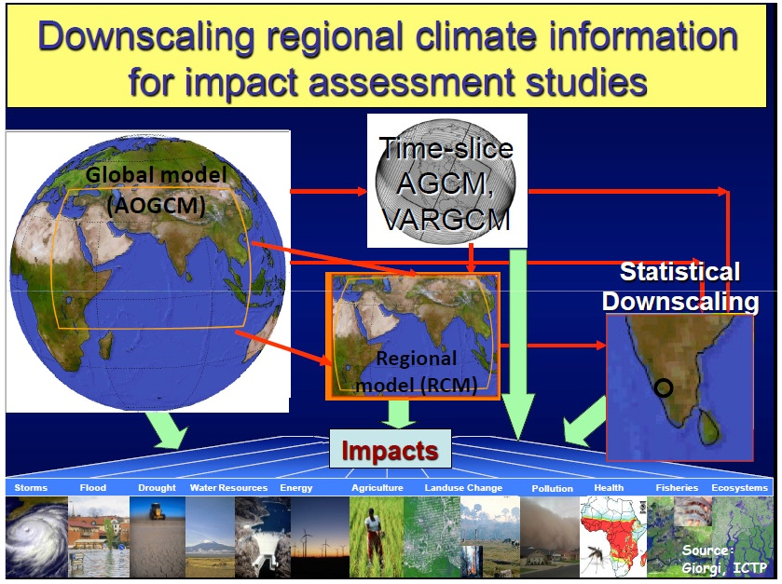
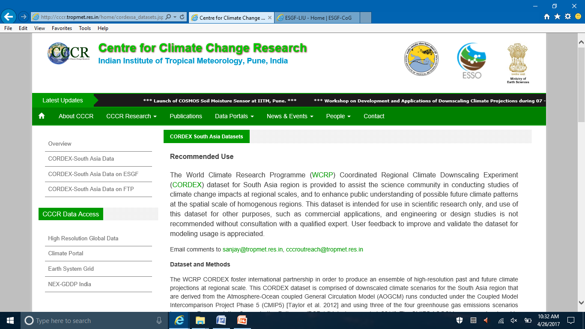
Regional Climate Information for Application Studies
CORDEX South Asia
https://cordex.org/domains/region-6-south-asia-2/
is leading CORDEX (Coordinated Regional Climate Downscaling Experiment) over South Asia Region
High Resolution (50 km) Dynamical Downscaling of CMIP5 Climate Projections based on RCP Scenarios during 1950-2100 using multiple RCMs
  More information for CORDEX South Asia data access from CCCR-IITM Climate Data Portal and ESGF datanode are provided at: http://cccr.tropmet.res.in/home/cordexsa_datasets.jsp

Slide 3
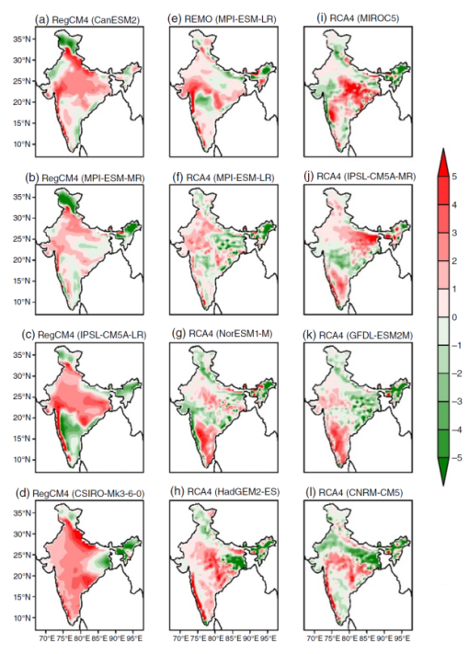
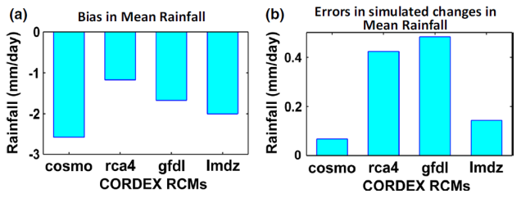
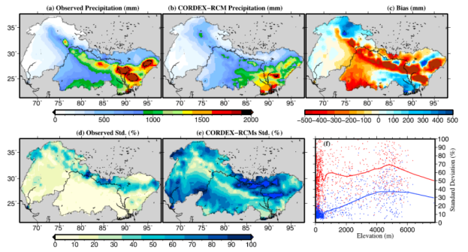
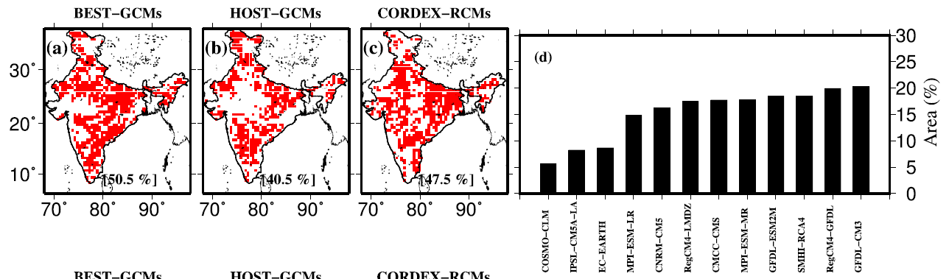
CORDEX South Asia (WAS) Activities
Opportunities and Challenges for better assessment of regional climate change
More than 40 research publications (2014 onwards) analysed the RCM outputs from the CORDEX South Asia ensemble (see http://cccr.tropmet.res.in/home/cordexsa_pub.jsp )
Future global meteorological drought hot spots: A study based on CORDEX Data (Spinoni et al., 2020)
Contrasting regional and global climate simulations over South Asia (Rana et al., 2020)
Added value of CORDEX-SA experiments in simulating monsoon precipitation over India (Choudhary etal.2018)
Understanding the cascade of GCM and downscaling (dynamical versus statistical) uncertainties in capturing the spatio-temporal variability of hydro-climatic projections over India (Sharma et al., 2017)
Do dynamic regional models add value to the global model projections of Indian monsoon? (Singh etal, 2017)
Climatic uncertainty in RCMs is far larger than observations over the Himalayan water towers
(Mishra 2015)
Reliability of regional and global climate models to simulate precipitation extremes over India
(Mishra et al., 2014)
ISMR (Fig. 16, Singh et al., 2017)
AV JJAS mean precip (Fig. 2, Choudhary et al., 2018)
Ensemble mean JJAS 1951-2007 (Fig. 4, Mishra 2015)
Grid cells (in red) where models show bias (±10%) for 1 day precip maxima at 25 year return period and (d) models and the area (%) (Fig. 9, Mishra et al. 2014)

Slide 4
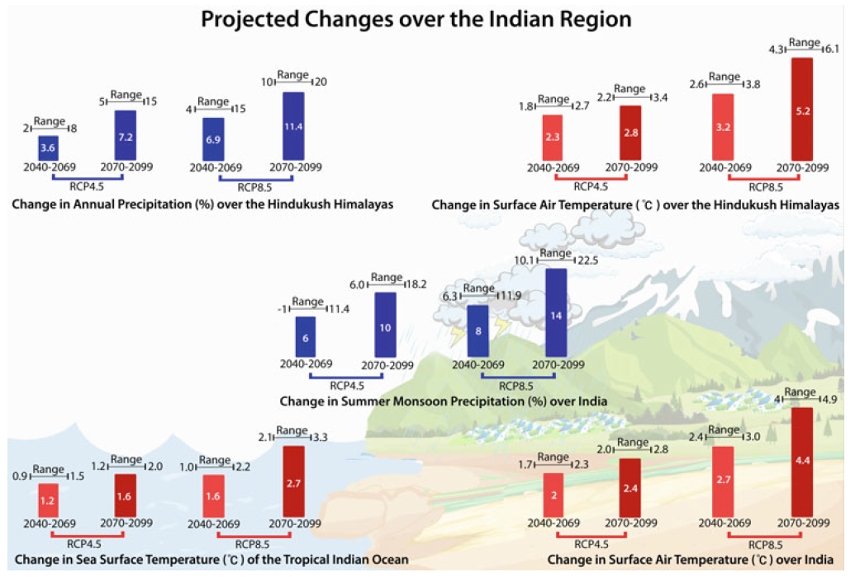
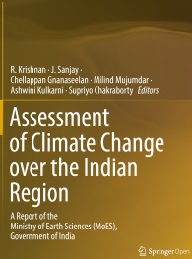
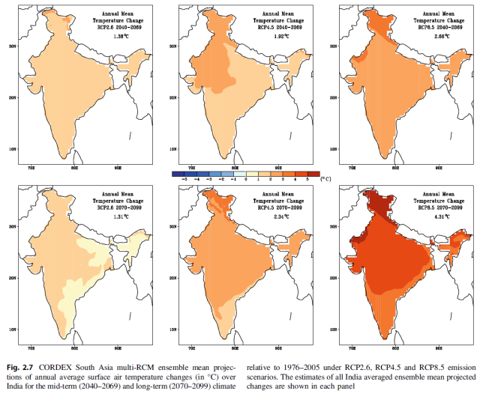
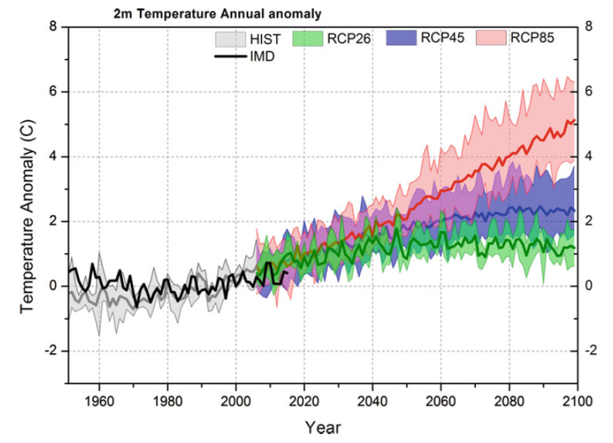
CORDEX South Asia future projections of regional climate change over India
(In Krishnan et al., 2020)
Source:
Krishnan et al., (2020) SpringerNature;
https://doi.org/10.1007/978-981-15-4327-2

Slide 5
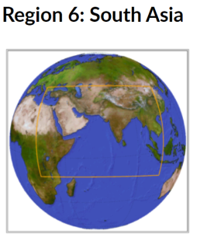
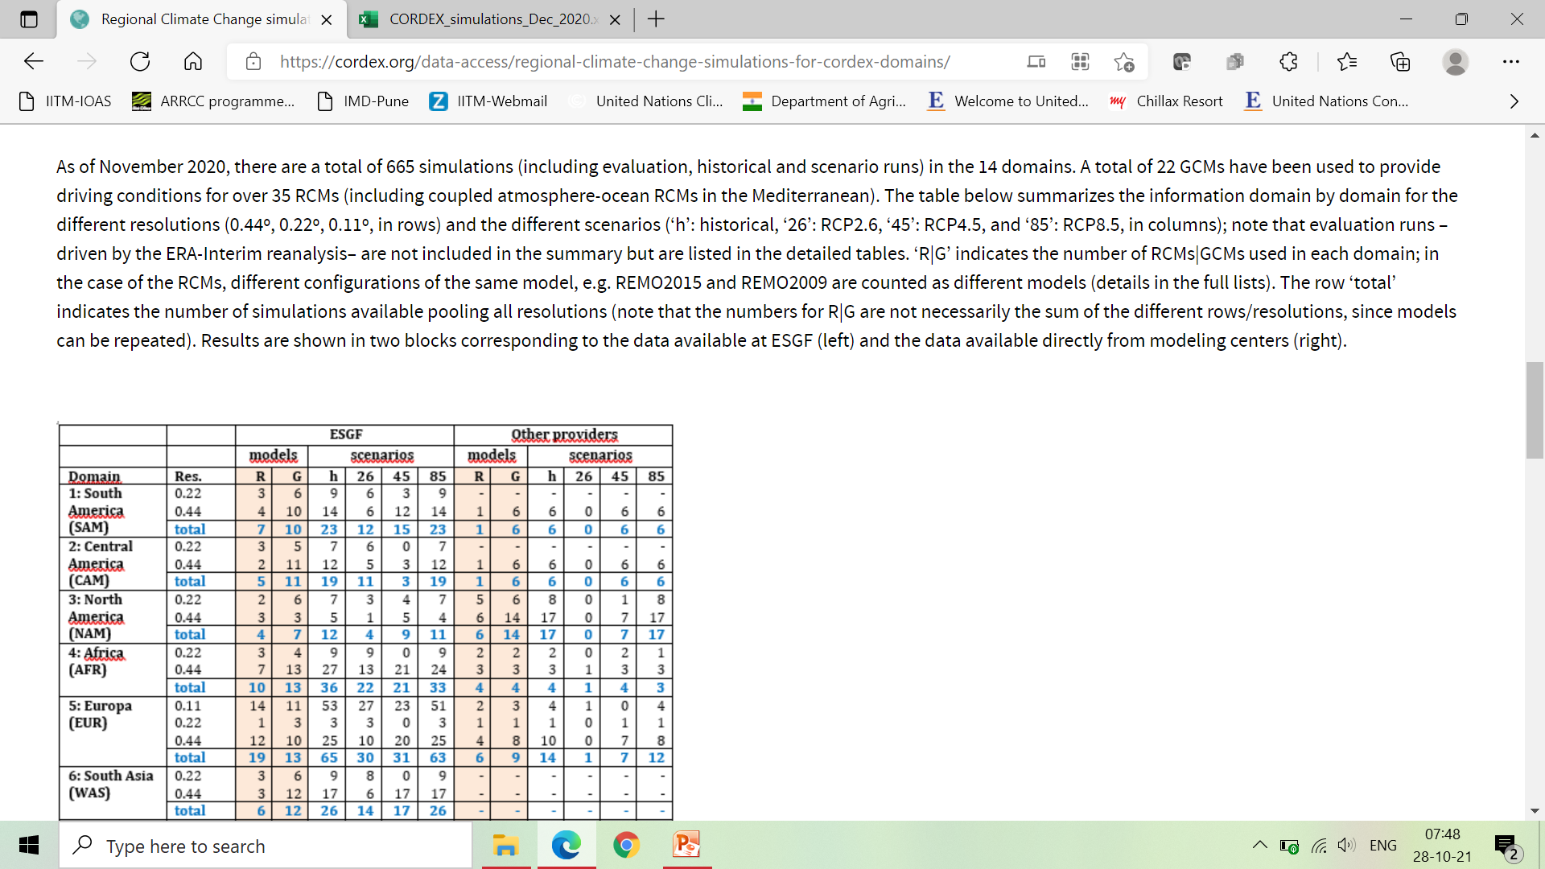
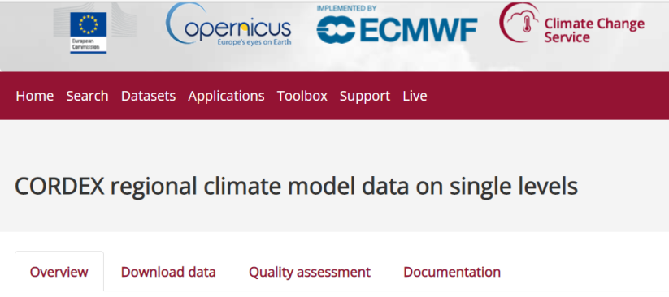
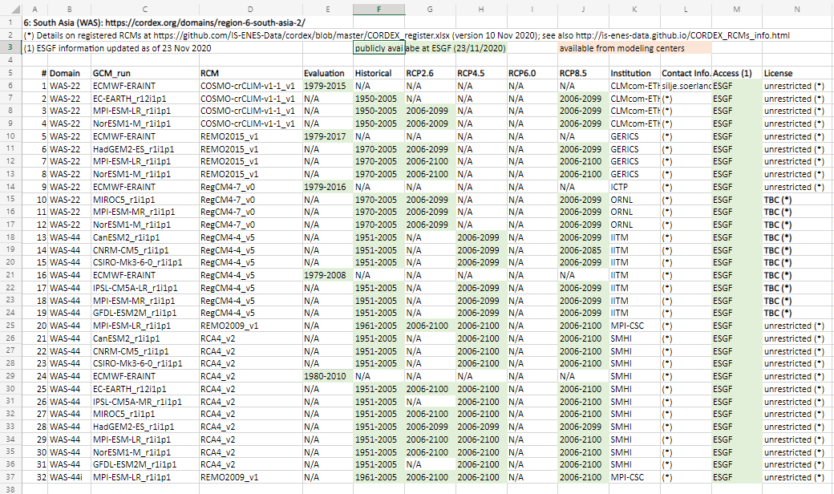
CORDEX simulations are stored in a distributed archive
(the Earth System Grid Federation, ESGF) after standardization & curation: https://cordex.org/data-access/regional-climate-change-simulations-for-cordex-domains/
Climate Data Store (CDS) CORDEX data subset
The CDS subset of CORDEX data is an effort done by Copernicus to consolidate a World-wide CORDEX dataset, and has also contributed to the IPCC-AR6 WGI activities
https://cds.climate.copernicus.eu/cdsapp#!/dataset/projections-cordex-domains-single-levels?tab=overview
https://cordex.org/wp-content/uploads/2020/12/CORDEX_simulations_Dec_2020.xlsx

Slide 6
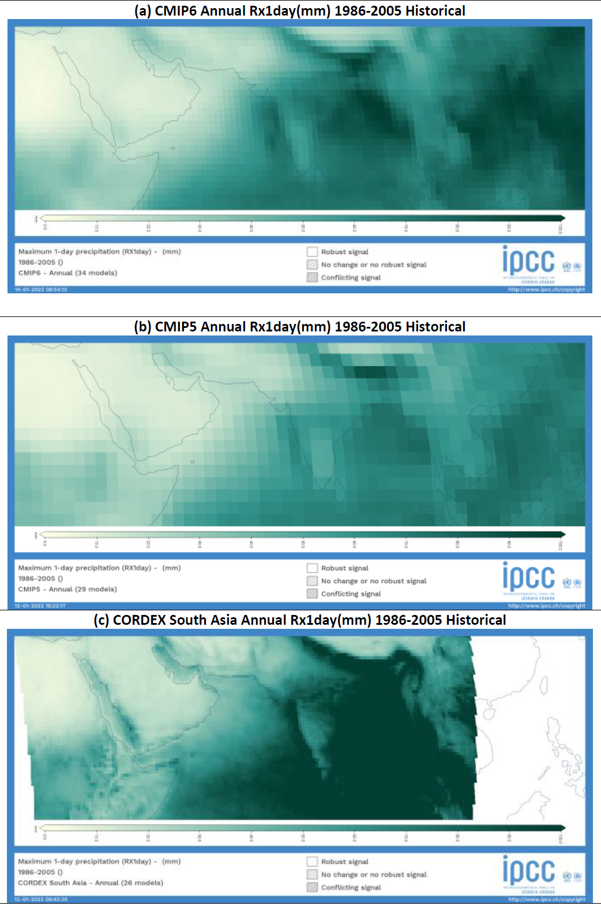
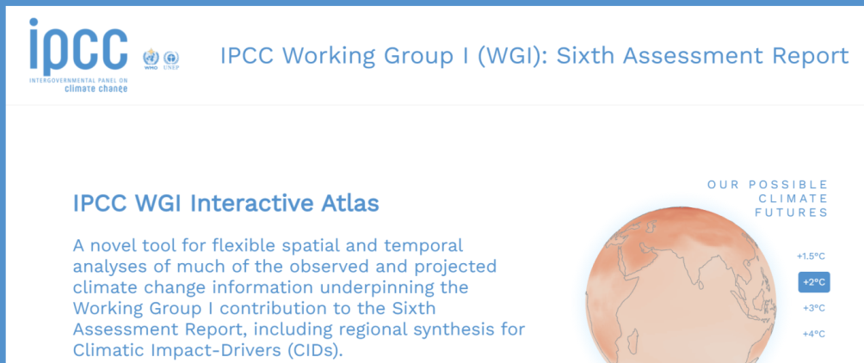
Spatial distribution of annual maximum 1-day precipitation (Rx1day, mm) over South Asia and adjoining regions averaged for the historical reference period 1986-2005 from the multi-model ensemble (MME) mean of global (CMIP6 and CMIP5) and downscaled regional (CORDEX South Asia) historical climate simulations.
Rx1day is an index for CID category Heavy Precipitation & Pluvial Floods
The spatial maps are drawn online using the IPCC Interactive Atlas
(Gutiérrez et al., 2021;
https://interactive-atlas.ipcc.ch/ )

Slide 7
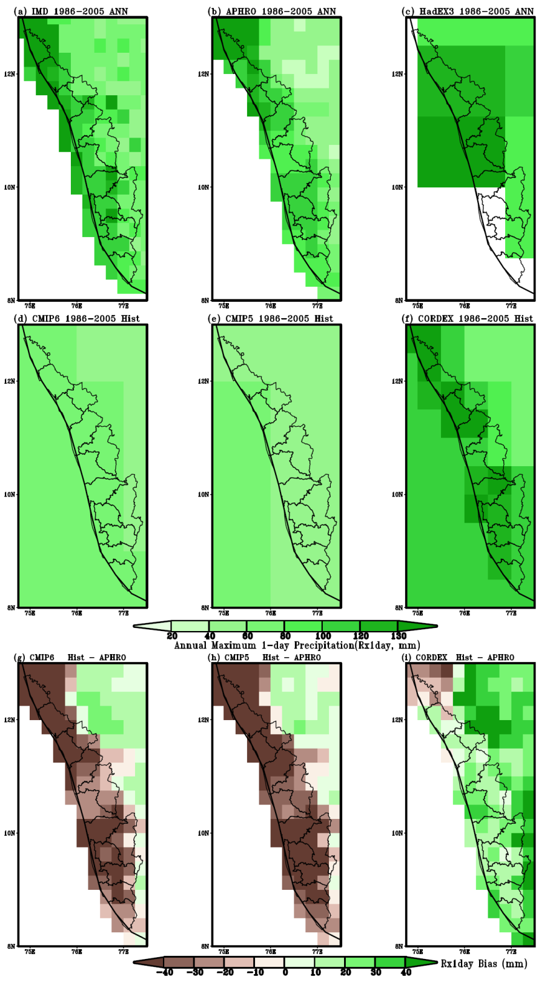
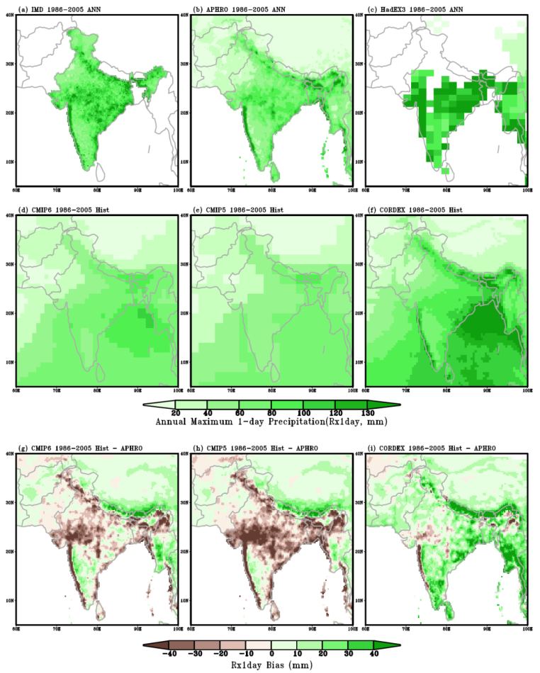
Climate Models Simulated
Regional to Local Precipitation Extremes
HadEX3
IMD
APHRO
Climatological spatial distribution of Rx1day magnitudes over the Kerala State and adjoining regions shows that the downscaled high resolution CORDEX MME mean simulated the intense precipitation extremes relatively closer to observed (APHRODITE) estimates than the coarse resolution CMIP5 and CMIP6 MME means.
CMIP6
CMIP5
CORDEX
Rx1day Mean
Rx1day Bias
The spatial maps are drawn using the data extracted from IPCC Interactive Atlas
(Gutiérrez et al., 2021; https://interactive-atlas.ipcc.ch/ )

Slide 8
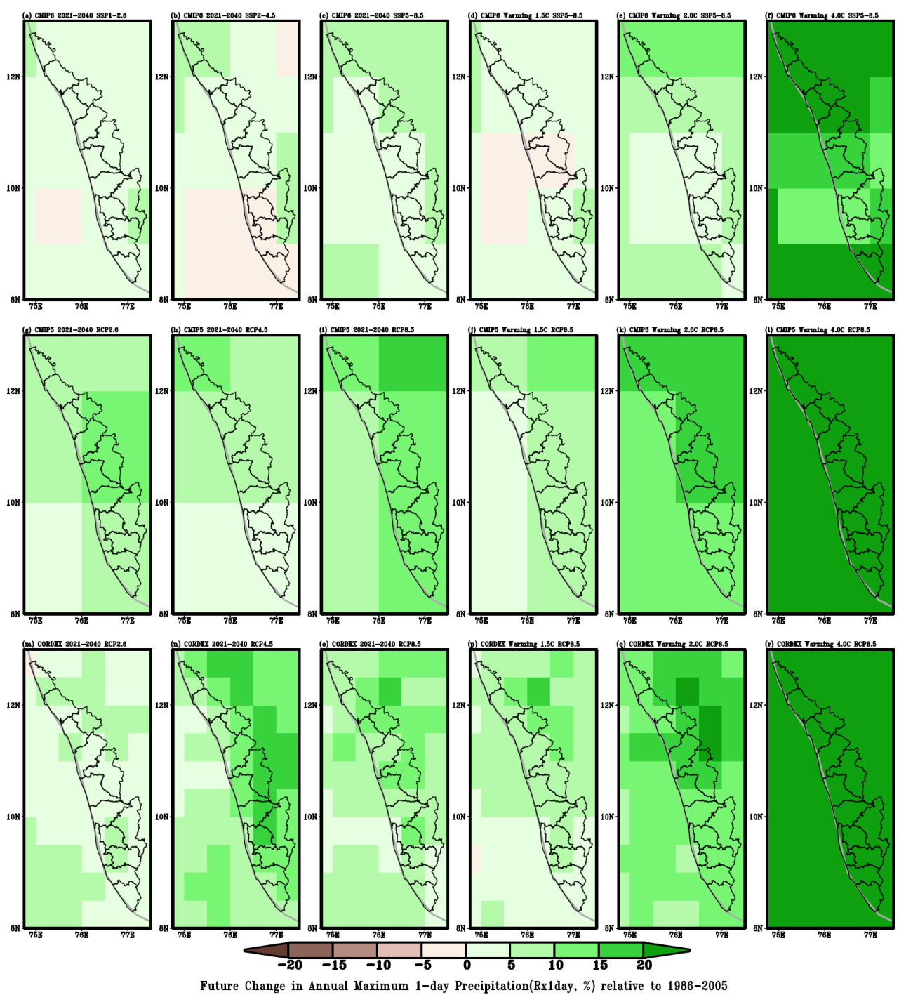
Climate Change Driven Changes in Precipitation Extremes
Near-Term (2021-2040) Scenario
Low Medium High
Global Warming Levels
1.5°C 2.0°C 4.0°C
CMIP6
Analyses of MME mean global and downscaled regional climate projections implies that scenarios with low GHG emissions (RCP2.6 and SSP1-2.6) would lead to substantially smaller changes in annual Rx1day index beyond 2040 than under very high GHG emissions scenarios (RCP8.5 and SSP5-8.5) over the Kerala State and adjoining regions
CMIP5
CORDEX
The spatial maps are drawn using the data extracted from IPCC Interactive Atlas (Gutiérrez et al., 2021;
https://interactive-atlas.ipcc.ch/ )

Slide 9
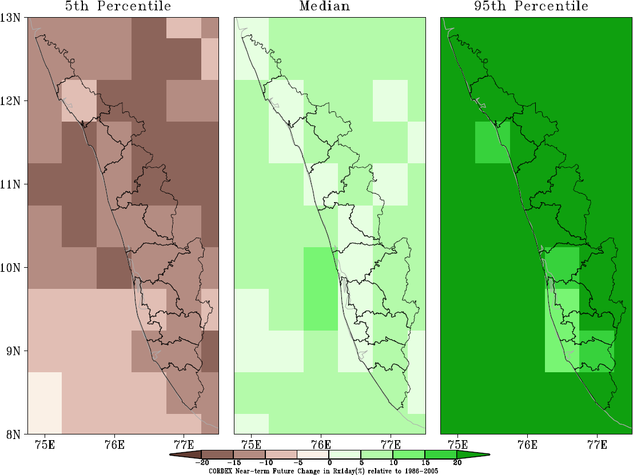
Summary & Knowledge Gaps……
The evaluation of global and downscaled regional climate model performance will provide confidence to the analyses of projected changes from these model outputs.
Climate information as provided by the IPCC may be too coarse, too broad or too disciplinary to directly inform decision-making at the national, local or sectoral level where adaptation planning measures are taken
IPCC AR6 had assessed that there is high confidence that Climate Services has set new scientific challenges to physical climate research
Understanding and modelling of weather and climate extremes is of great relevance for Climate Services, and is continuing to set challenges for research, such as modelling changes in impact-relevant threshold exceedance and return periods for a variety of extremes

Slide 10
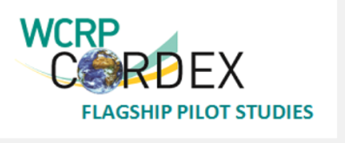
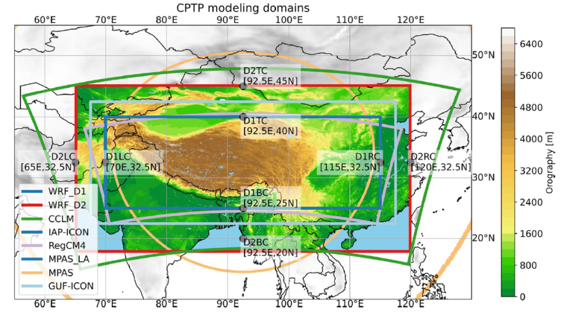
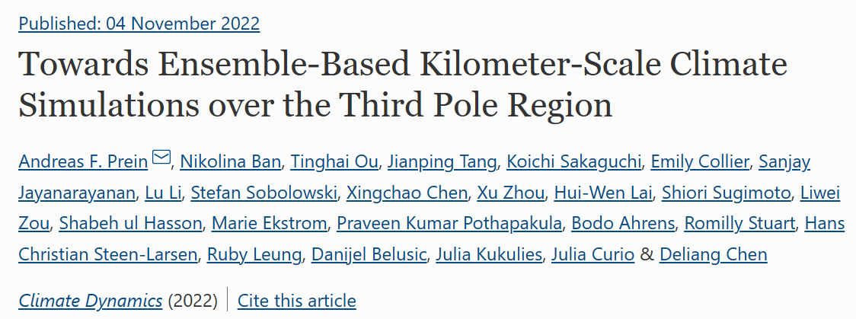
Convection-Permitting Third Pole (CPTP)
CORDEX-FPS: High resolution climate modeling with a focus on mesoscale convective systems and associated precipitation
over the Third Pole region
http://rcg.gvc.gu.se/cordex_fps_cptp/
CCCR-IITM is a modeling partner in this five year (2020-2024) International
CORDEX Flagship Pilot Study (FPS) project
  This FPS aims to better understand the regional characteristics of water cycle and its variabilities and changes over the TP and adjoining regions using a set of coordinated high resolution regional climate downscaling experiments carried out by international participants with a focus on convection-permitting simulations (2-5 km) using different models or model setups.
The first results from multi-model, multi-physics ensemble simulations of three case studies show high performance across a range of meteorological situations and are close to available observational estimates in simulating precipitation and near-surface temperature.
https://doi.org/10.1007/s00382-022-06543-3

Slide 11
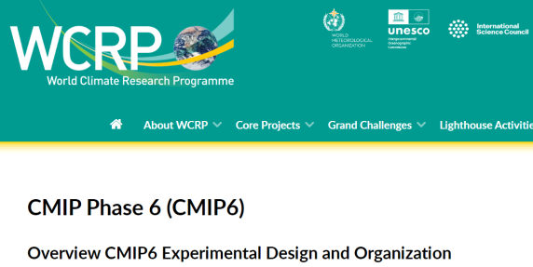
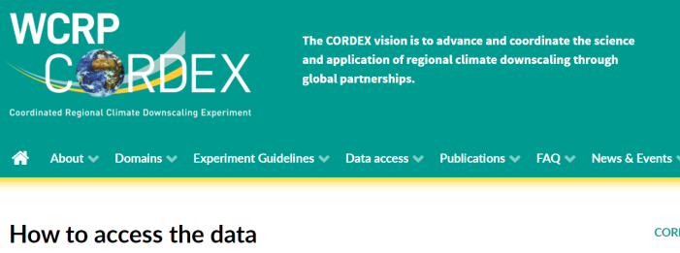
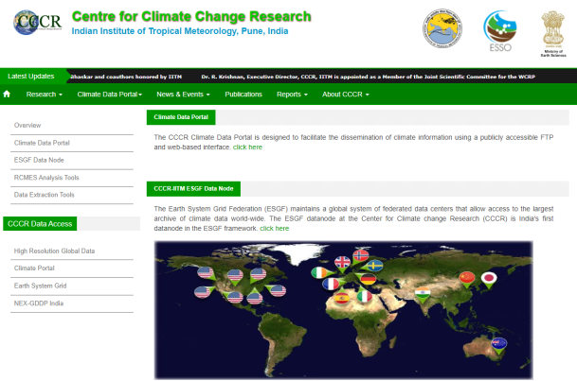
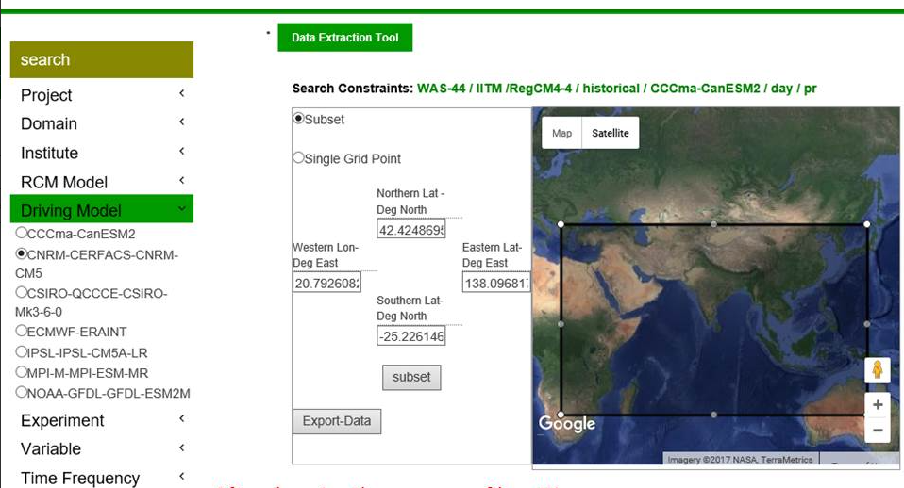
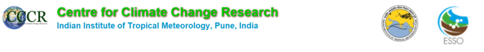
https://www.wcrp-climate.org/wgcm-cmip/wgcm-cmip6
https://cordex.org/data-access/how-to-access-the-data/
http://cccr.tropmet.res.in/home/data_portals.jsp
Thanks for your attention
Email: sanjay@tropmet.res.in
Thank You
  ICRC-CORDEX 2023 Organisers
  Director IITM
  CCCR-IITM Team Members

