Slide 1
Investigating the seasonal variation of simulated carbonaceous fine particulate matter over six homogeneous regions of India with a focus on the IGP region
Indian Institute of Tropical Meteorology, Pune
ICRC-CORDEX Conference
Praveen Kumar
Senior Research Fellow
Supervision By
Dr. Gufran Beig, Scientist G

Slide 2
Contents
Introduction
Methodology
Results
Conclusions
References

Slide 3
Introduction
Carbonaceous fine particulate matter (C-PM) consists of BC and OC, known as short-lived climate forcing agents (SLCF).
BC and OC have a warming and cooling effect on the atmosphere due to the absorption and reflection of incoming solar radiation.
BC may lead to cloud lifetime changes and affect monsoons via aerosol-cloud interaction (Wang et al., 2021).
Air quality has been a significant concern over the decades due to increasing emissions of BC and OC in Asian countries (Xu et al., 2021).
BC is considered a significant element that may contribute to global warming in addition to greenhouse gases (Ramanathan and Carmichael, 2008; Shaw et al., 2021) and also a second contributor to global warming after CO2. BC may significantly absorb solar radiation, which warms the atmosphere (Wang et al., 2021).

Slide 4
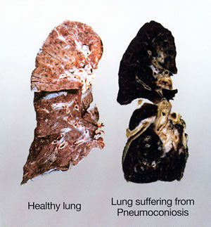
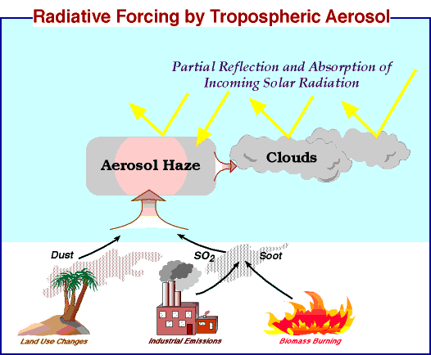
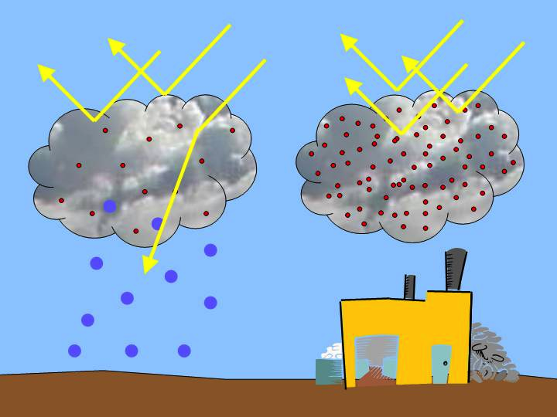
Carbonaceous fine PMs have (direct or indirect) effect on meteorological degradation and radiative forcing (Watson 2002) as well as changes in radiation budget, circulation pattern, and cloud albedo (Ramanathan et al. 2001).
OC and EC have vital effects on air quality, atmospheric visibility, climate, and human health.

Slide 5
Methodology
Modeled data:
In this study, we are using WRF-Chem model with a version 3.9.1.1. – with 1 nested domains, , which are shown in below figure-
NCEP FNL
Global anthropogenic emissions
MEGAN biogenic emissions
FINN fire emissions
lateral boundary and initial conditions
Physical Scheme
Chemistry scheme
WRF-Chem version 3.9.1.1 was set up to perform air quality forecasting and use one nest domain-
1. Largest domain – 45 km resolution with 194 x 130 grid cell.
2. Second domain – 15 km resolution with 259 x 256
Continue ……

Slide 6
WRF-Chem Input Library
Sr. No. | Process | Description
1. | Chemical mechanism | MOZART chemistry (option 112)
2. | Microphysics | Thompson Graupel scheme
3. | Longwave radiation | Rapid Radiative Transfer Model (RRTM)
4. | Shortwave radiation | Rapid Radiative Transfer Model (RRTM) (Mlawer et al., 1997)
5. | PBL Physics | Bougeault and Lacarrere (BouLac) PBL
6. | Cumulus physics | Grell 3D ensemble scheme
7. | Surface layer | Noah Land Surface Model (Chen and Dudhia, 2001)
8. | Photolysis | Madronich F-TUV photolysis
9. | Aerosol Chemistry | GOCART aerosol
10. | Dust | GOCART dust emissions
11. | Photolysis | Madronich F-TUV
12. | Anthropogenic emissions | EDGAR HTAP
13. | Biogenic emissions | MEGAN
14. | FIRE emissions | NCAR version-1 (FINNv1)
15. | Boundary conditions | MOZART

Slide 7
Results
a)
b)
Figure 2 (a & b): Spatial distribution of black and organic carbon emission rate with two emission inventories like EDGAR HTAPs v2.2 and SAFAR 2018.

Slide 8
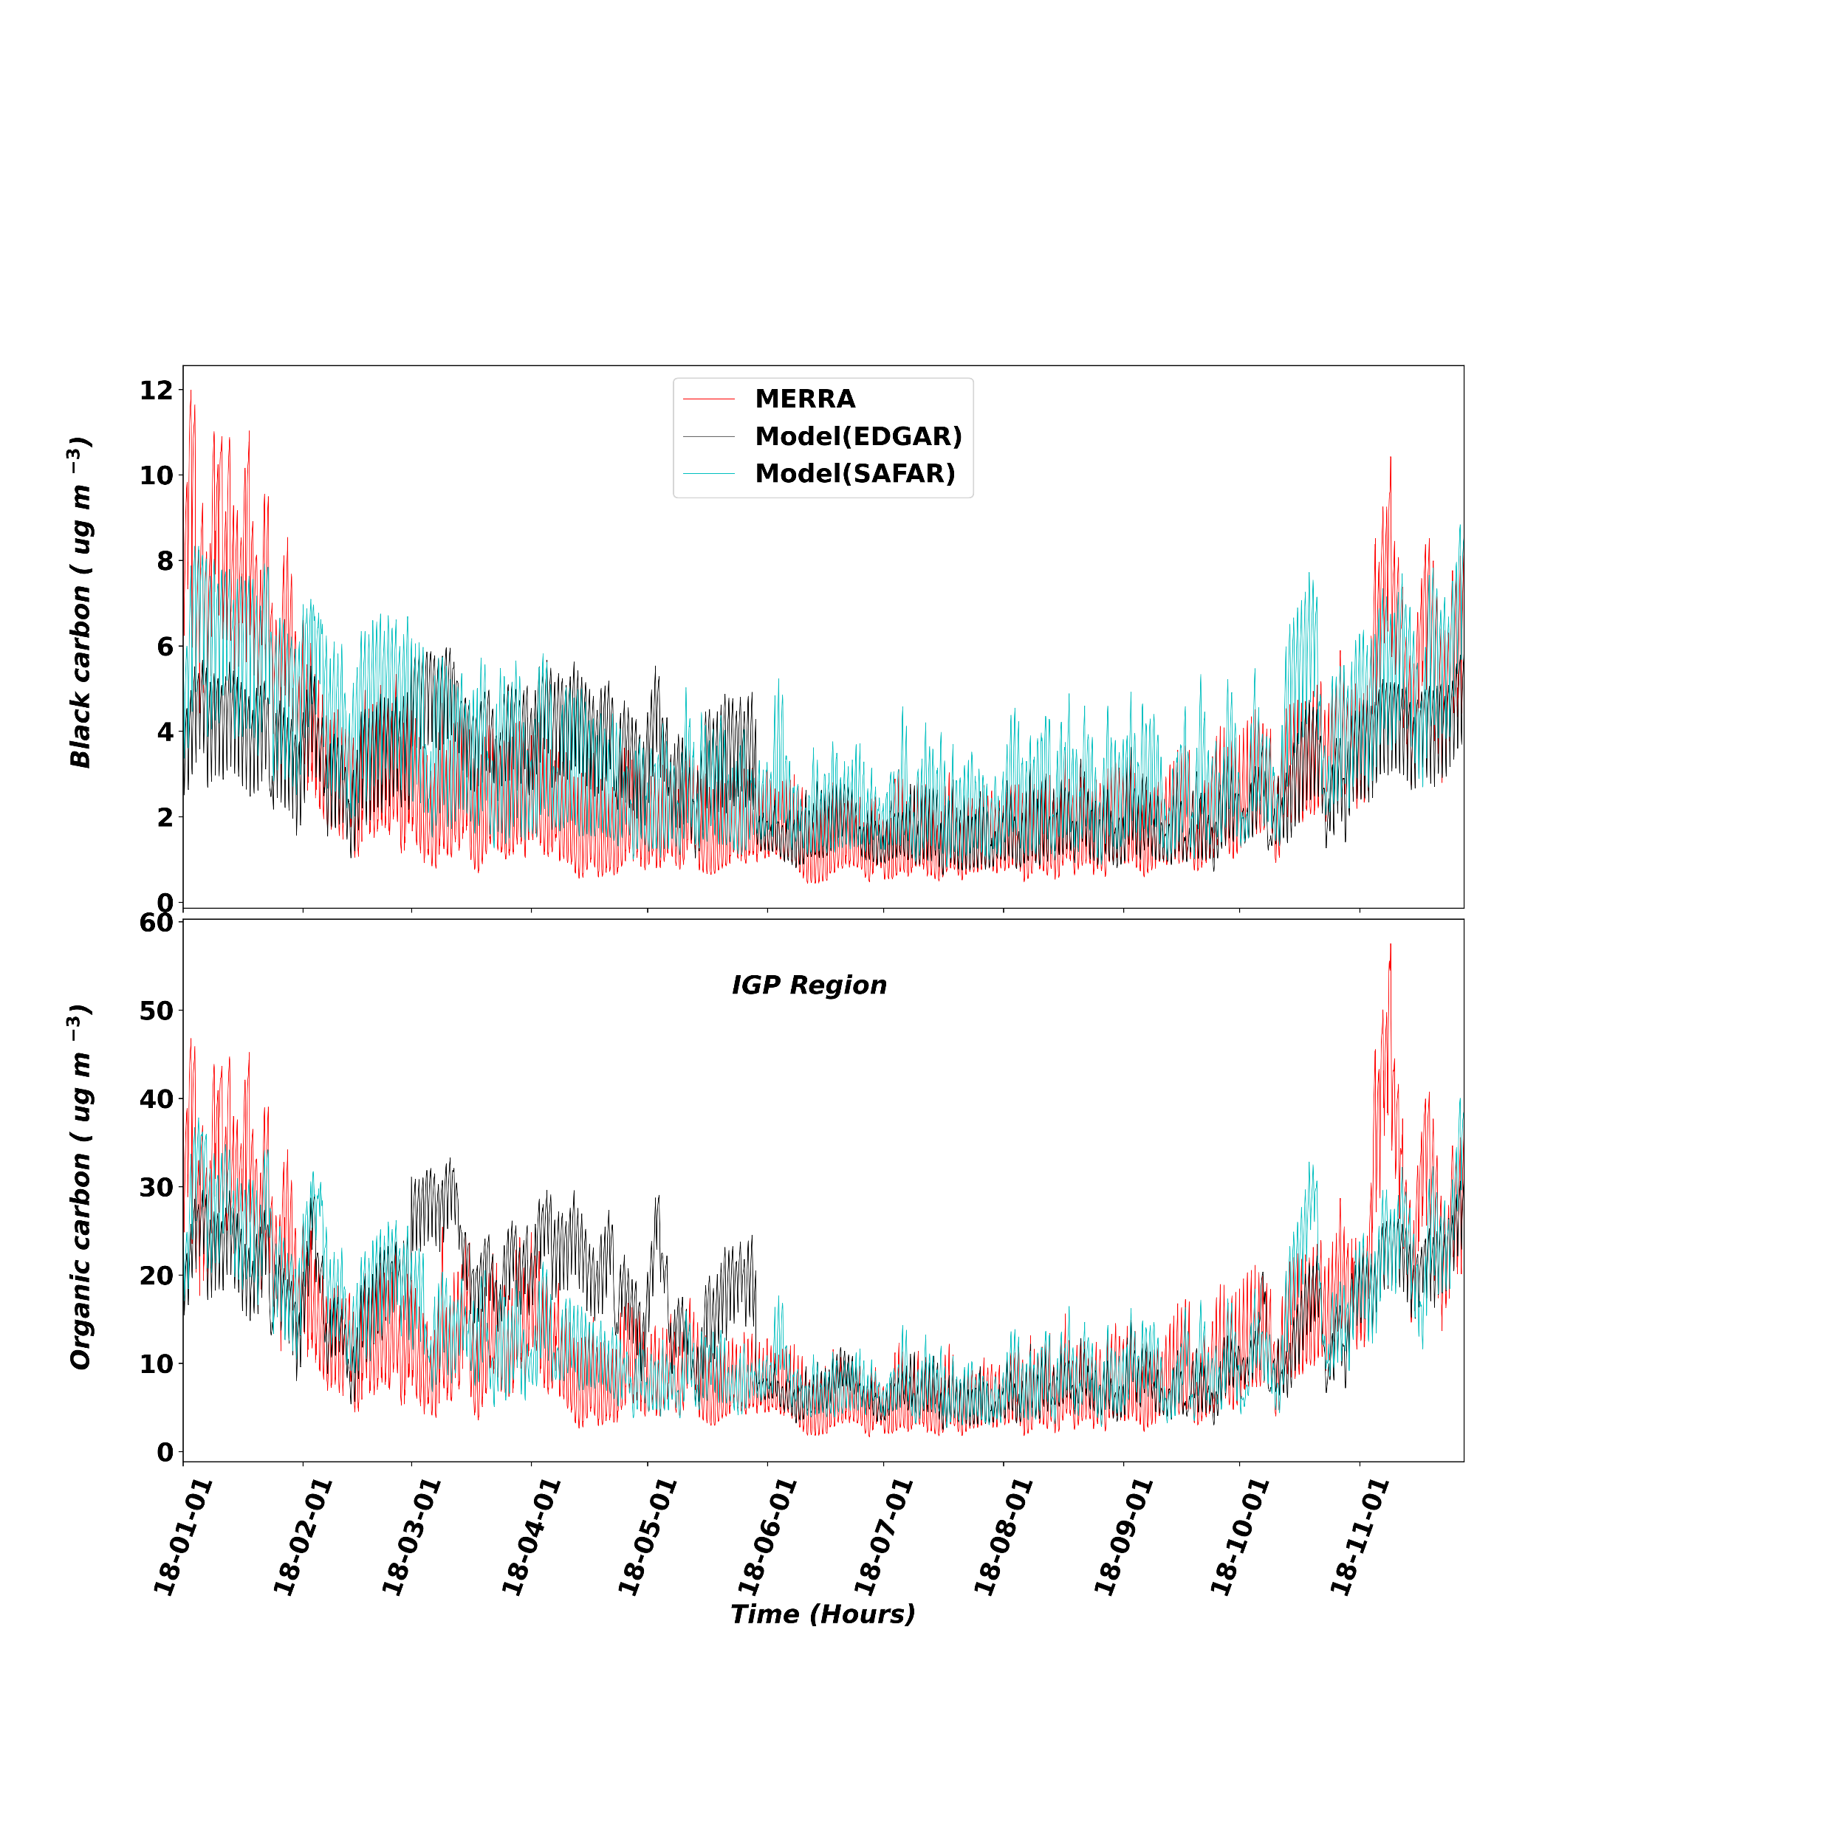
Results
Variables |  | BC (ug m⁻³) | OC (ug m⁻³) | T (K) | PBLH (m) | WS (m s⁻¹)
Mean | MERRA | 2.86 | 13.00 | 300.21 | 1240 | 2.97
 | SAFAR | 3.15 | 14.57 | 299.49 | 1036 | 2.22
 | EDGAR | 2.12 | 11.08 | 296.84 | 1030 | 2.21
CC | Me&Sf | 0.75 | 0.83 | 0.91 | 0.71 | 0.69
 | Me&Ed | 0.65 | 0.59 | 0.89 | 0.67 | 0.65
Mean Bias | Me&Sf | 0.29 | 1.56 | -0.72 | -204 | 0.75
Bias | Me&Ed | -0.74 | -1.98 | -3.37 | -210 | 0.76
RMSE | Me&Sf | 0.45 | 1.60 | 2.67 | 274 | 0.65
 | Me&Ed | 0.87 | 1.90 | 3.63 | 278 | 0.69
Table 1: Annual comparison of simulated pollutants and meteorological parameters with observation
Figure 3: Temporal variation of the BC & OC

Slide 9
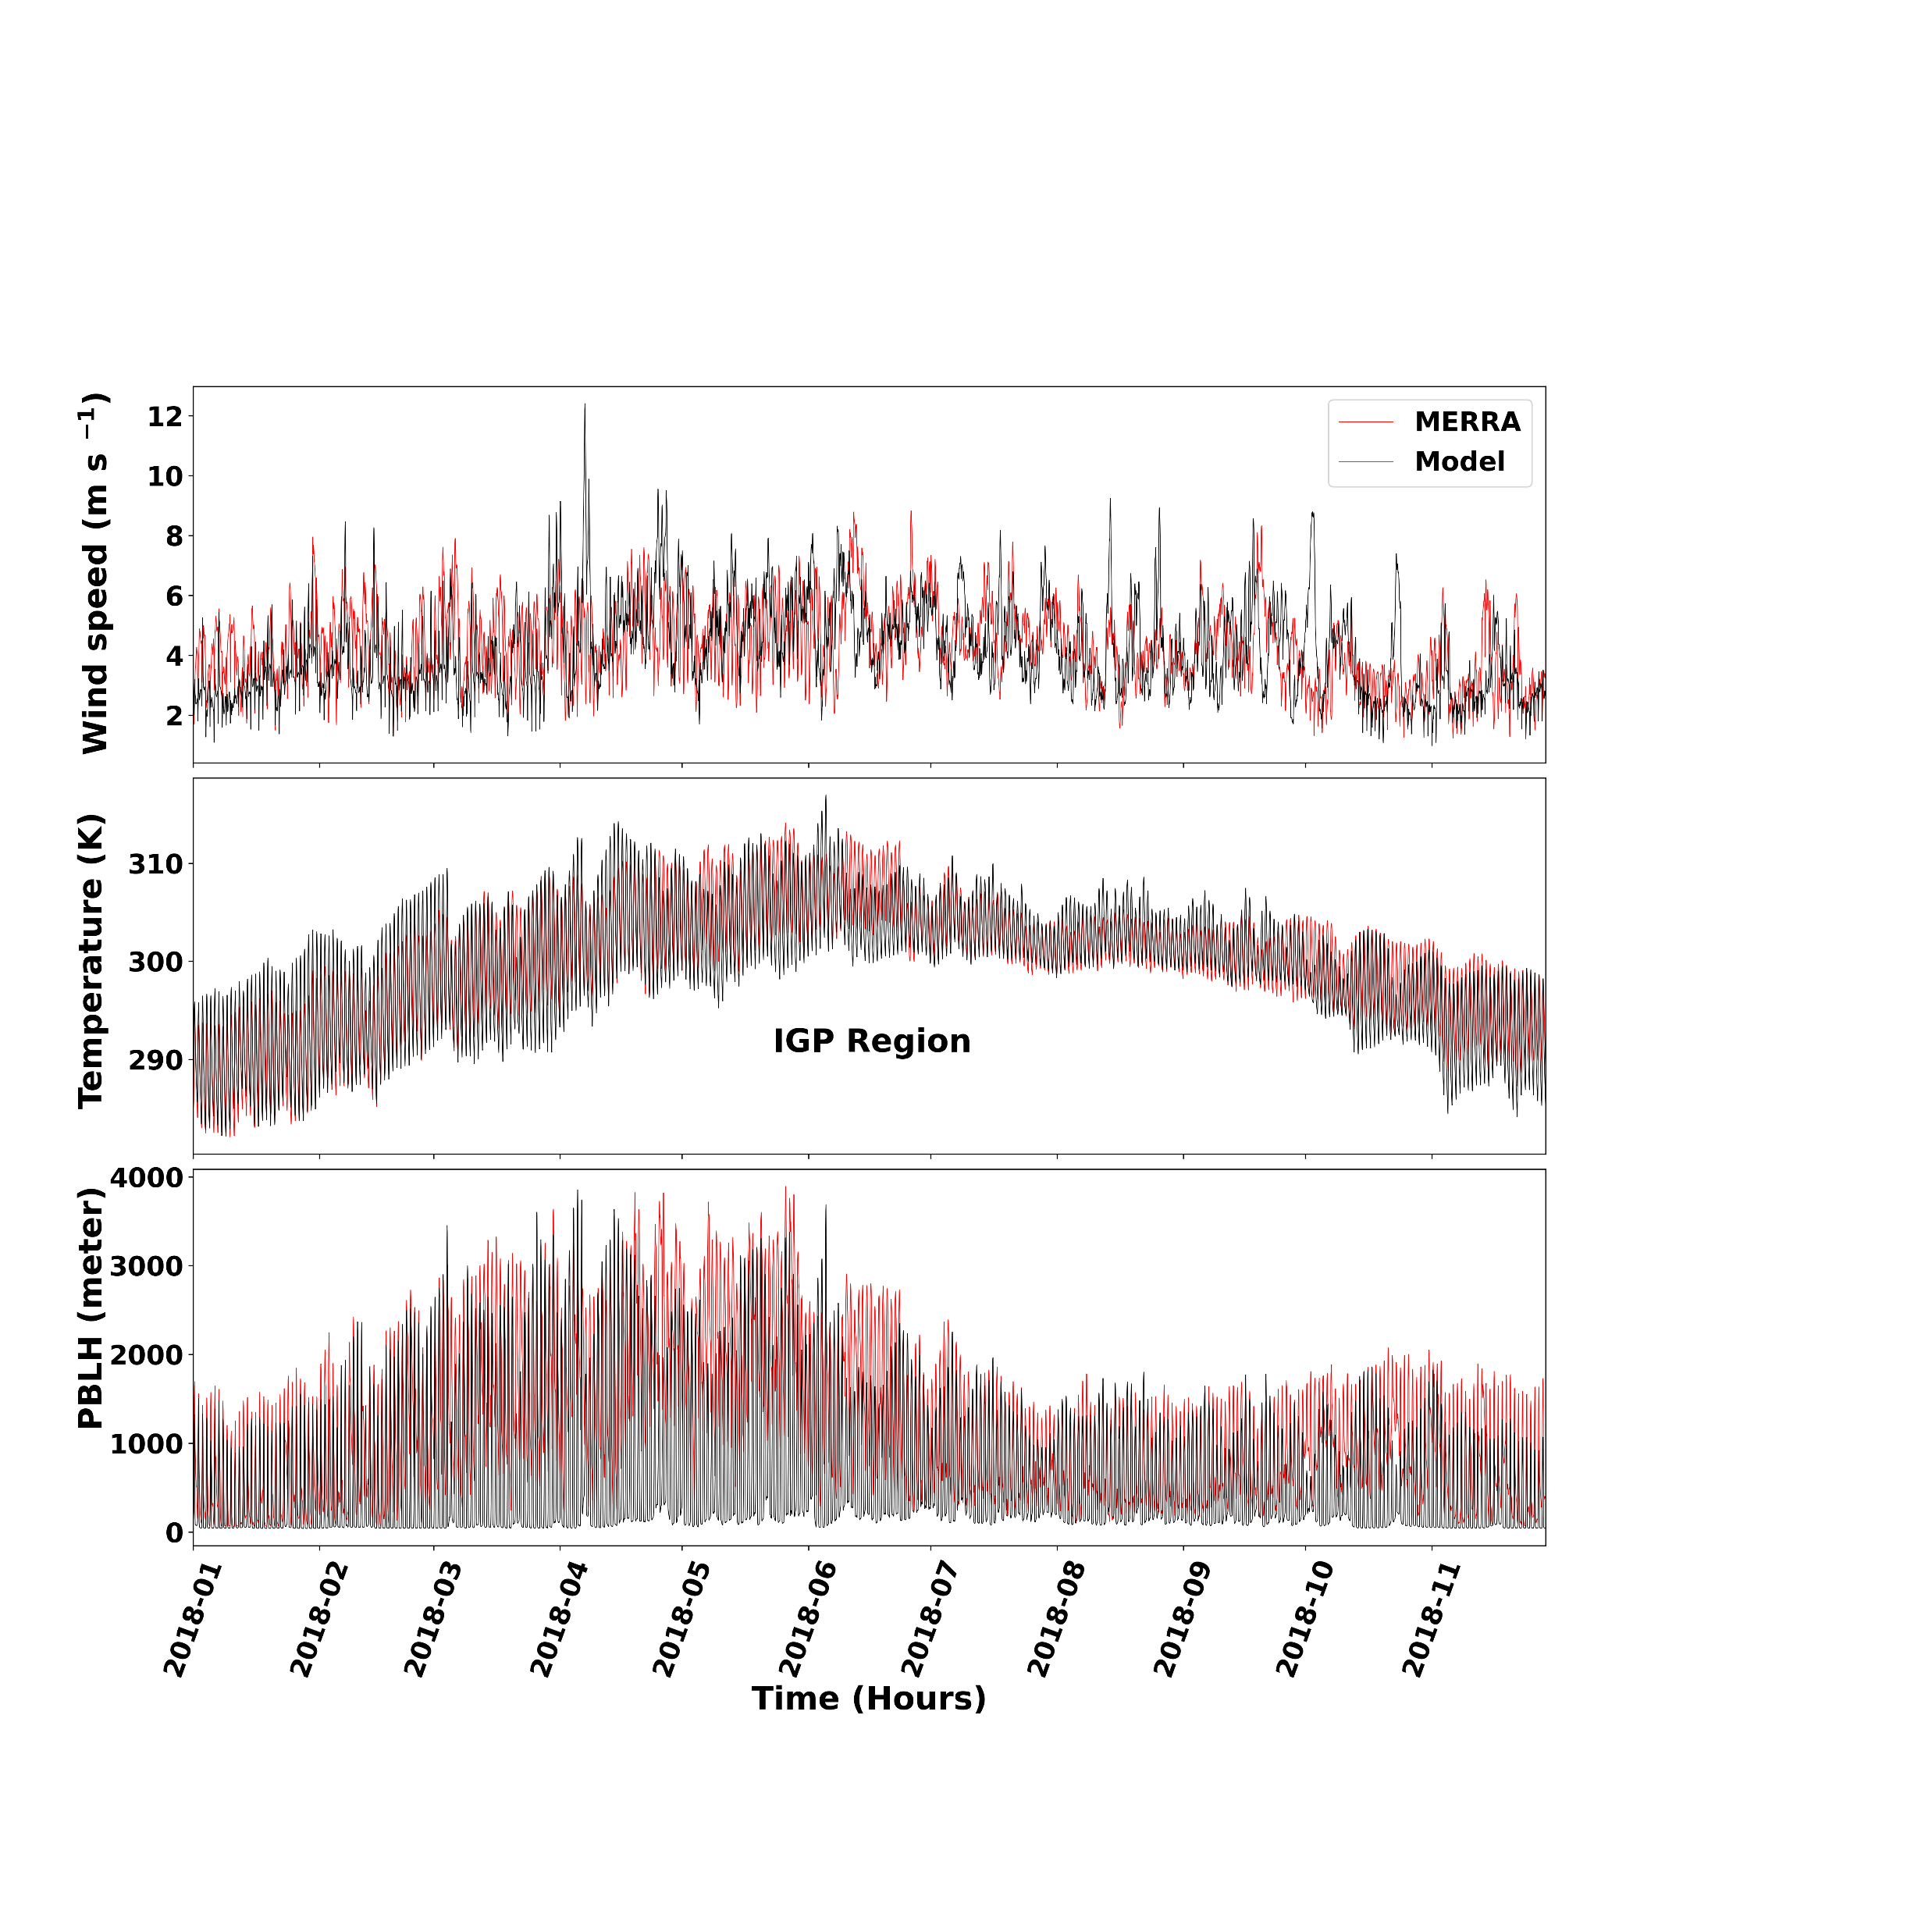
Results
Figure 4: Temporal variation of meteorological parameters (wind speed, temperature, PBL height) of MERRA reanalysis (red color) and model (black color)

Slide 10
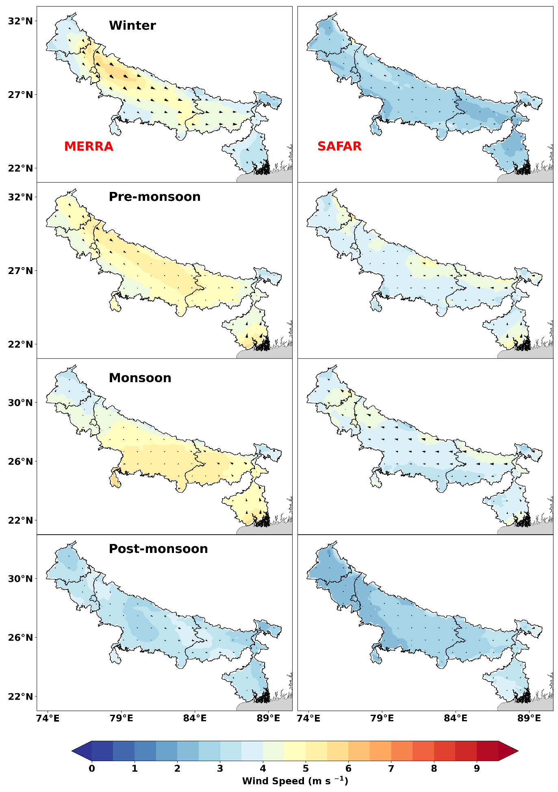
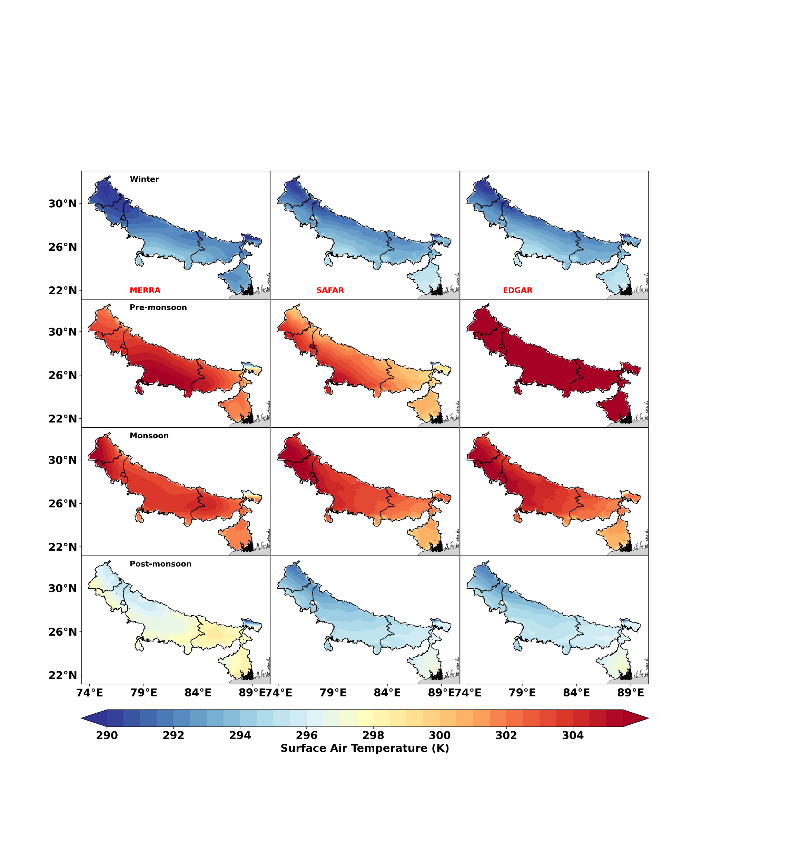
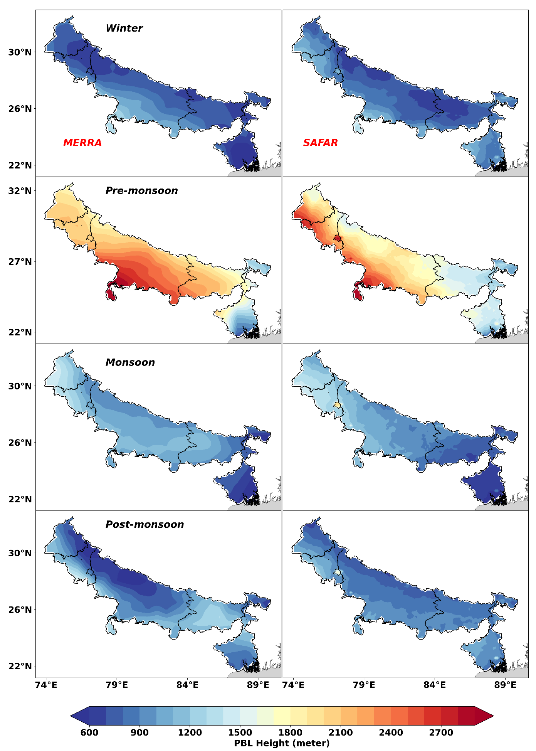
Results
Figure 5 (a b, & c): Spatial and seasonal variation of wind speed and direction (a), temperature (b) and PBL height (c) from MERRA and model simulated with EDGAR and SAFAR 2018 emission inventory for 2018.

Slide 11
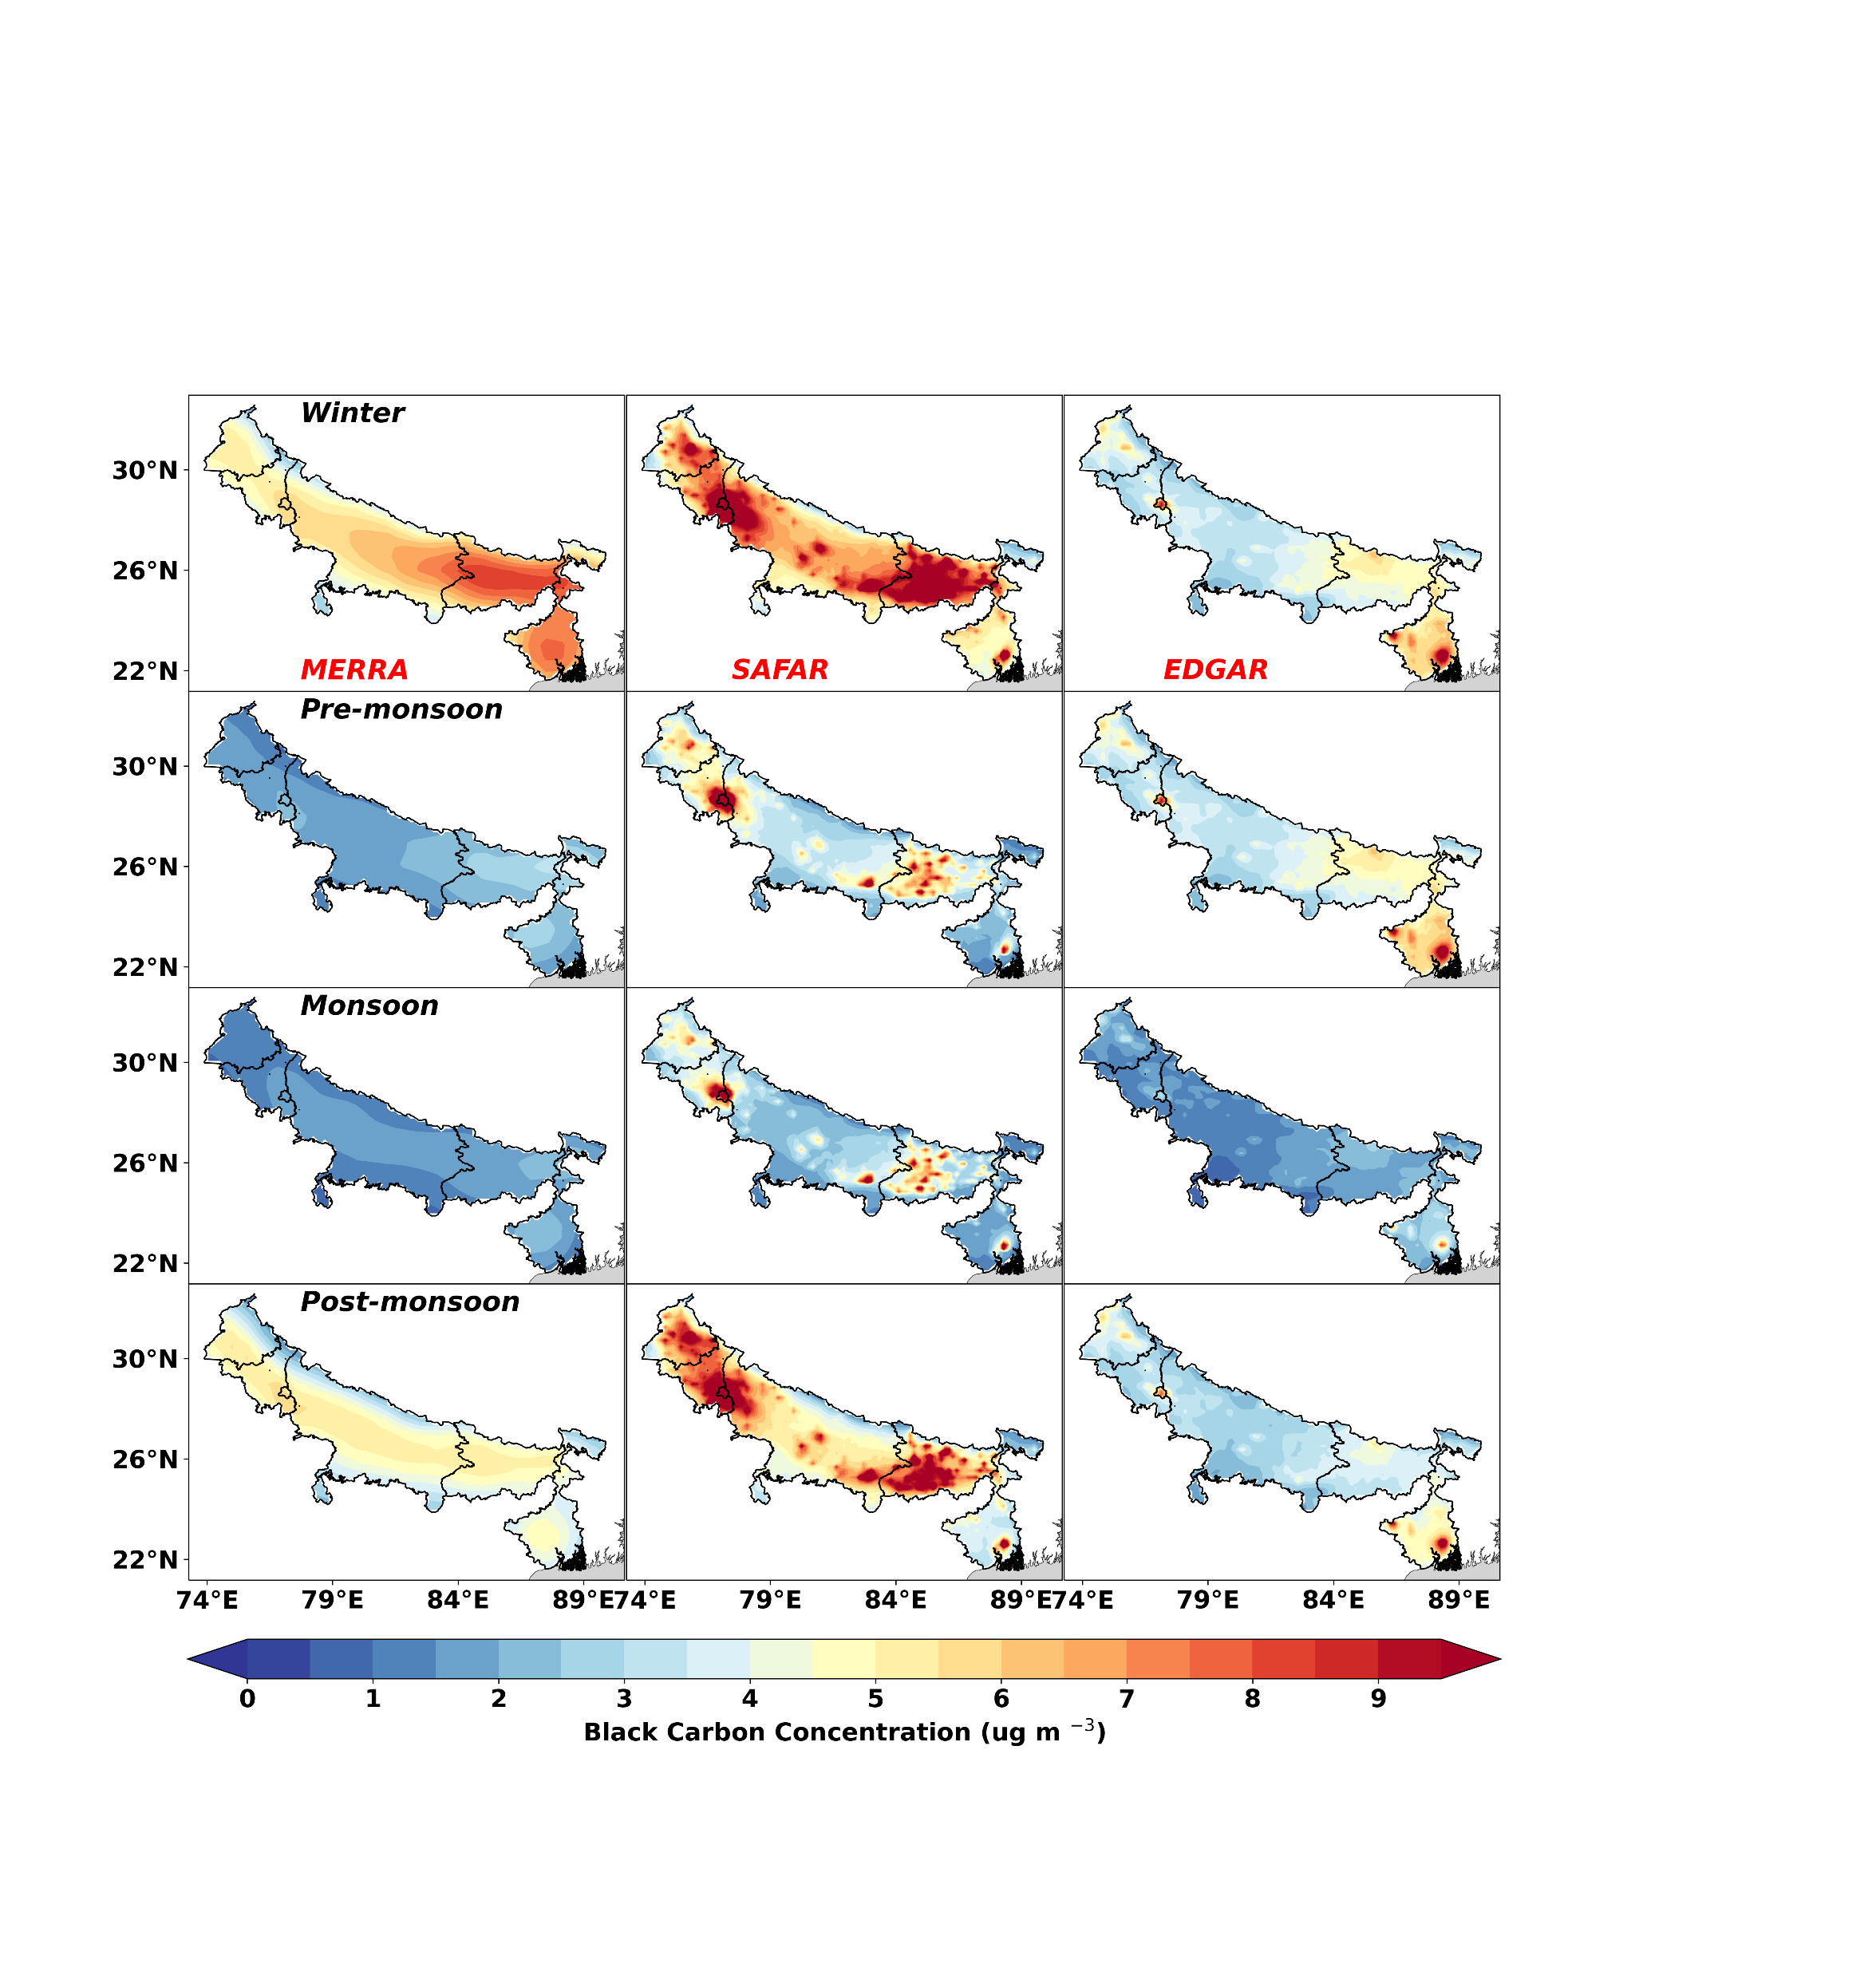
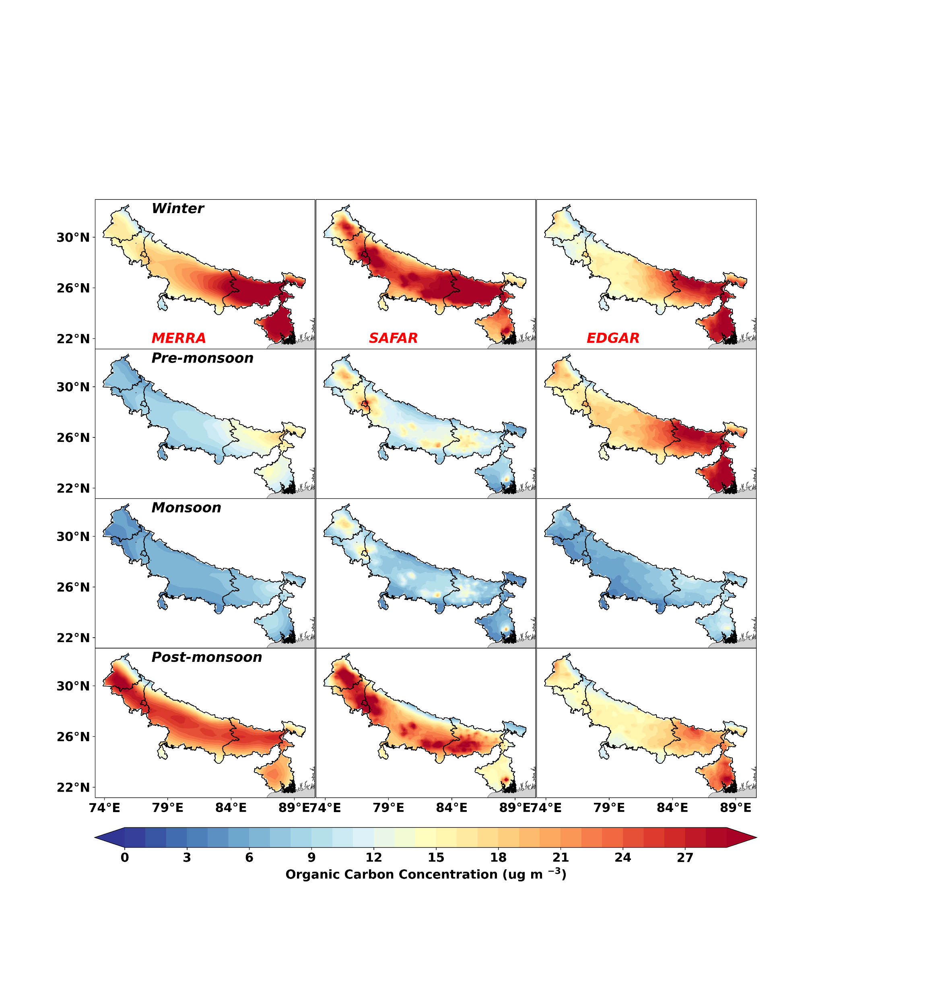
Results
Figure 6 (a & b): Spatial and seasonal variation of Organic carbon (a) and Black carbon (b) from MERRA and model simulated with EDGAR and SAFAR 2018 emission inventory for 2018.

Slide 12
Conclusions
The simulation provided a clear perspective on the seasonal variations and regional concentration patterns over the Indian region.
The simulated wind produced a realistic spatial pattern, but the magnitudes were relatively small.
The annual hourly time series of meteorological parameters correlated well with MERRA.
The Model simulated spatial pattern of the seasonal mean surface temperature at 2 m, wind speed, and PBL height showed better agreement with MERRA.
The annual hourly time series of surface BC_{Sf} concentrations over the IGP region were slightly higher correlated (R= 0.75), respectively, with MERRA as compared to BC_{Ed} (R= 0.65) concentrations.
The annual hourly time series of surface BC_{Sf} concentrations within the IGP region were slightly higher correlated (R= 0.83), respectively, with MERRA as compared to BC_{Ed} (R= 0.59) concentrations.
Model-simulated spatial patterns of seasonal mean BC with SAFAR-2018 emission inventory and MERRA have a greater agreement than EDGAR emission inventory.

Slide 13
References
Beig, G., Sahu, S. K., Anand, V., Bano, S., Maji, S., Rathod, A., ...&Trimbake, H. K. (2021a). India’s Maiden air quality forecasting framework for megacities of divergent environments: The SAFAR-project. Environmental Modelling& Software, 145, 105204.
Govardhan, G., Satheesh, S. K., Moorthy, K. K., &Nanjundiah, R. (2019). Simulations of black carbon over the Indian region: improvements and implications of diurnality in emissions. Atmospheric Chemistry and Physics, 19(12), 8229-8241.
Ramanathan, V., & Carmichael, G. (2008). Global and regional climate changes due to black carbon. Nature geoscience, 1(4), 221-227.
Shaw, K., Kennedy, C., &Dorea, C. C. (2021). Non-sewered sanitation systems’ global greenhouse gas emissions: balancing sustainable development goal tradeoffs to end open defecation. Sustainability, 13(21), 11884.
Wang, J., Ye, J., Zhang, Q., Zhao, J., Wu, Y., Li, J., ... & Jacob, D. J. (2021). Aqueous production of secondary organic aerosol from fossil-fuel emissions in winter Beijing haze. Proceedings of the National Academy of Sciences, 118(8).
Xu, H., Ren, Y. A., Zhang, W., Meng, W., Yun, X., Yu, X., ... & Tao, S. (2021). Updated global black carbon emissions from 1960 to 2017: Improvements, trends, and drivers. Environmental Science & Technology, 55(12), 7869-7879.
Ramanathan, V, P J Crutzen, J T Kiehl, and D Rosenfeld. 2001. “Aerosols, Climate, and the Hydrological Cycle.” Science 294 (5549): 2119 LP-2124. https://doi.org/10.1126/science.1064034.
Watson, John G. 2002. “Visibility: Science and Regulation.” Journal of the Air & Waste Management Association 52 (6): 628–713. https://doi.org/10.1080/10473289.2002.10470813

Slide 14
Thank You

